Slide 1
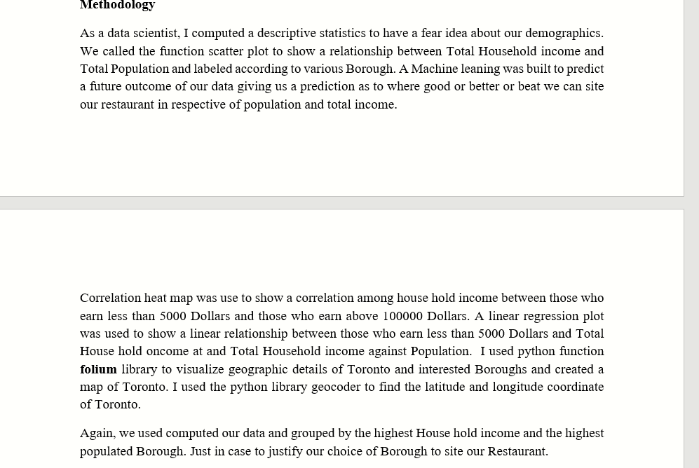
Toronto Restaurant

Slide 2
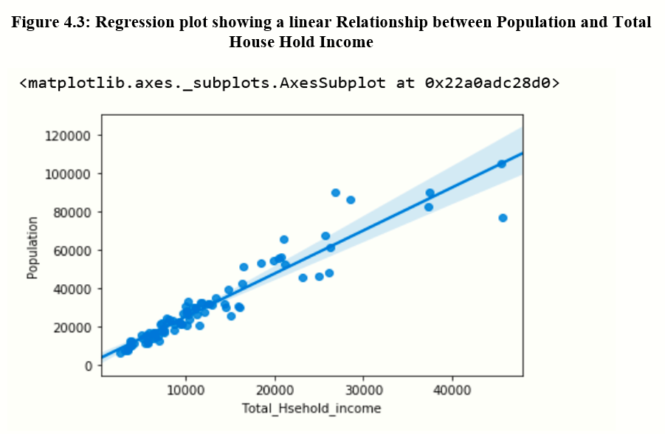
A Linear regression Between Population and Total House Hold Income

Slide 3
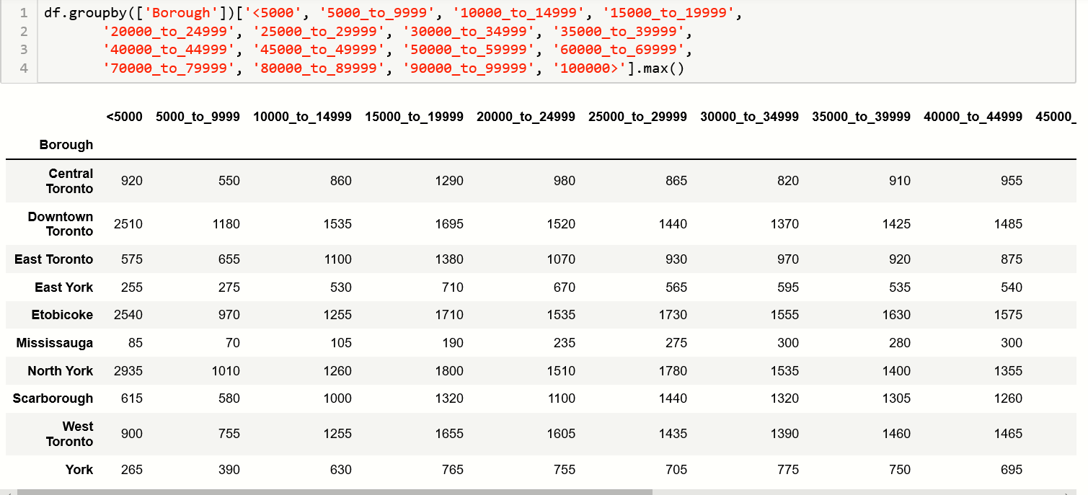
A descriptive Analysis showing maximum income received in each category of income according to various Income

Slide 4
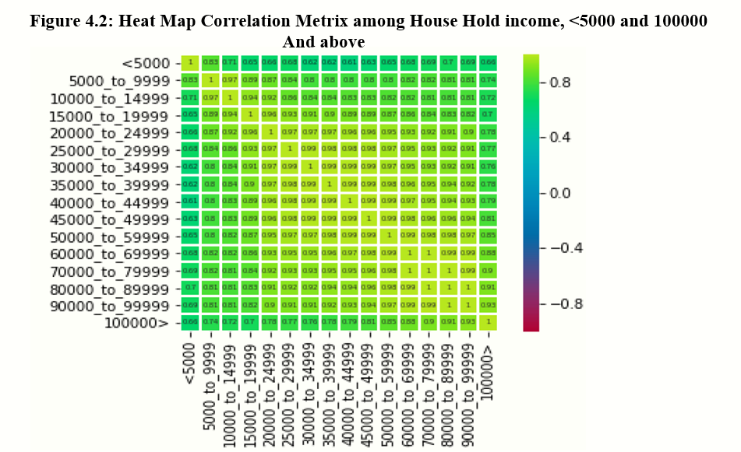
A heat Map Correlation Metrix showing correlations accros various Income

Slide 5
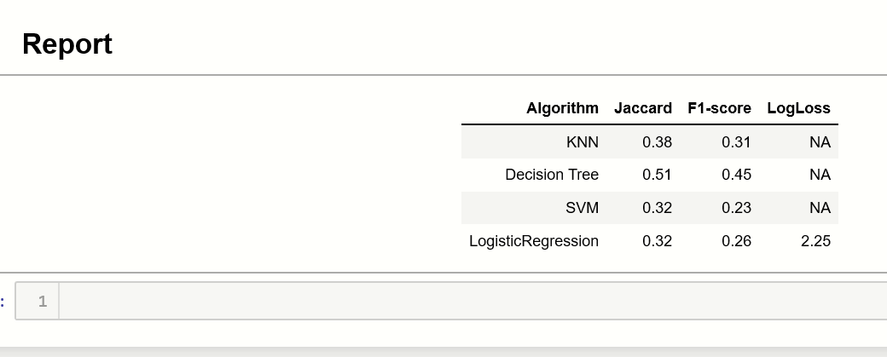
Our Report of Our Machine learning Argorithm on various Tests.

